Slide 1



Digital News Platform
Akkahshh Agarwaal
Himakar Sandiri
Lohith Gaddameedi
Date:08-08-2022

Slide 2
Introduction
-Build a web system that can display news.
-Users should be able to log in to a system.
-Every news item should have a like, comment, and share button.

Slide 3
Approach
-Database design
-RestAPI design
-Flow chart & screen mock-ups
-Studied about how to implement news API and how they work

Slide 4
Learnings
-RESTAPI : Java, Spring-boot
-Database : MySQL
-Front-end : Angular

Slide 5
Features
-Like button implementation
-Access to admin to delete any comment on any article..

Slide 6
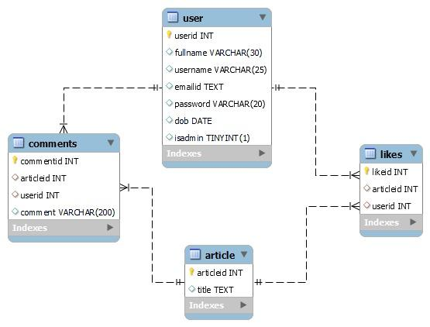
ER Diagram

Slide 7
AHL News
Top Headlines
Category
Search
Search
Login
Top Headlines
Image
Image
Image
Image
Title
Title
Title
Title
Read more
Read more
Read more
Read more
Image
Image
Image
Image
Title
Title
Title
Title
Read more
Read more
Read more
Read more

Slide 8
AHL News
Top Headlines
Category
Search
Search
Login
User Login
Username
Username
Password
Password
Sign In
Not a member? Register.

Slide 9
AHL News
Top Headlines
Category
Search
Search
Login
Register
Full Name
Full Name
Username
Username
Email ID
Email ID
Password
Password
Birth Date
DOB
Register
Already a member? Sign In.

Slide 10
AHL News
Top Headlines
Category
Search
Search
Profile
Top Headlines
Article Title
Article Image
Article Description
Image
Image
Image
Image
Title
Title
Title
Title
Read more
Read more
Read more
Read more
Image
Image
Image
Image
Title
Title
Title
Title
LIKE
SHARE
Read More
Read more
Read more
Read more
Read more

Slide 11
AHL News
Top Headlines
Category
Search
Search
Profile
Article Image
Article Description
Top Headlines
Comments (1)
Image
Image
Image
Image
Username
Comment
Title
Title
Title
Title
Read more
Read more
Read more
Read more
Add a comment
Add a comment …
Image
Image
COMMENT
Image
Image
Title
Title
Title
Title
LIKE
SHARE
Read More
Read more
Read more
Read more
Read more

Slide 12
THANK YOU

